Slide 1
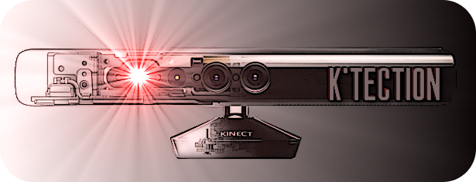
Microsoft Kinect
Collision Detection
Daniel Fischl 0825242
Manuel Hochmayr 0627715

Slide 2
Idea
Collision detection of person in a room
Applications:
  People with visual impairment
  Dark environments

Slide 3
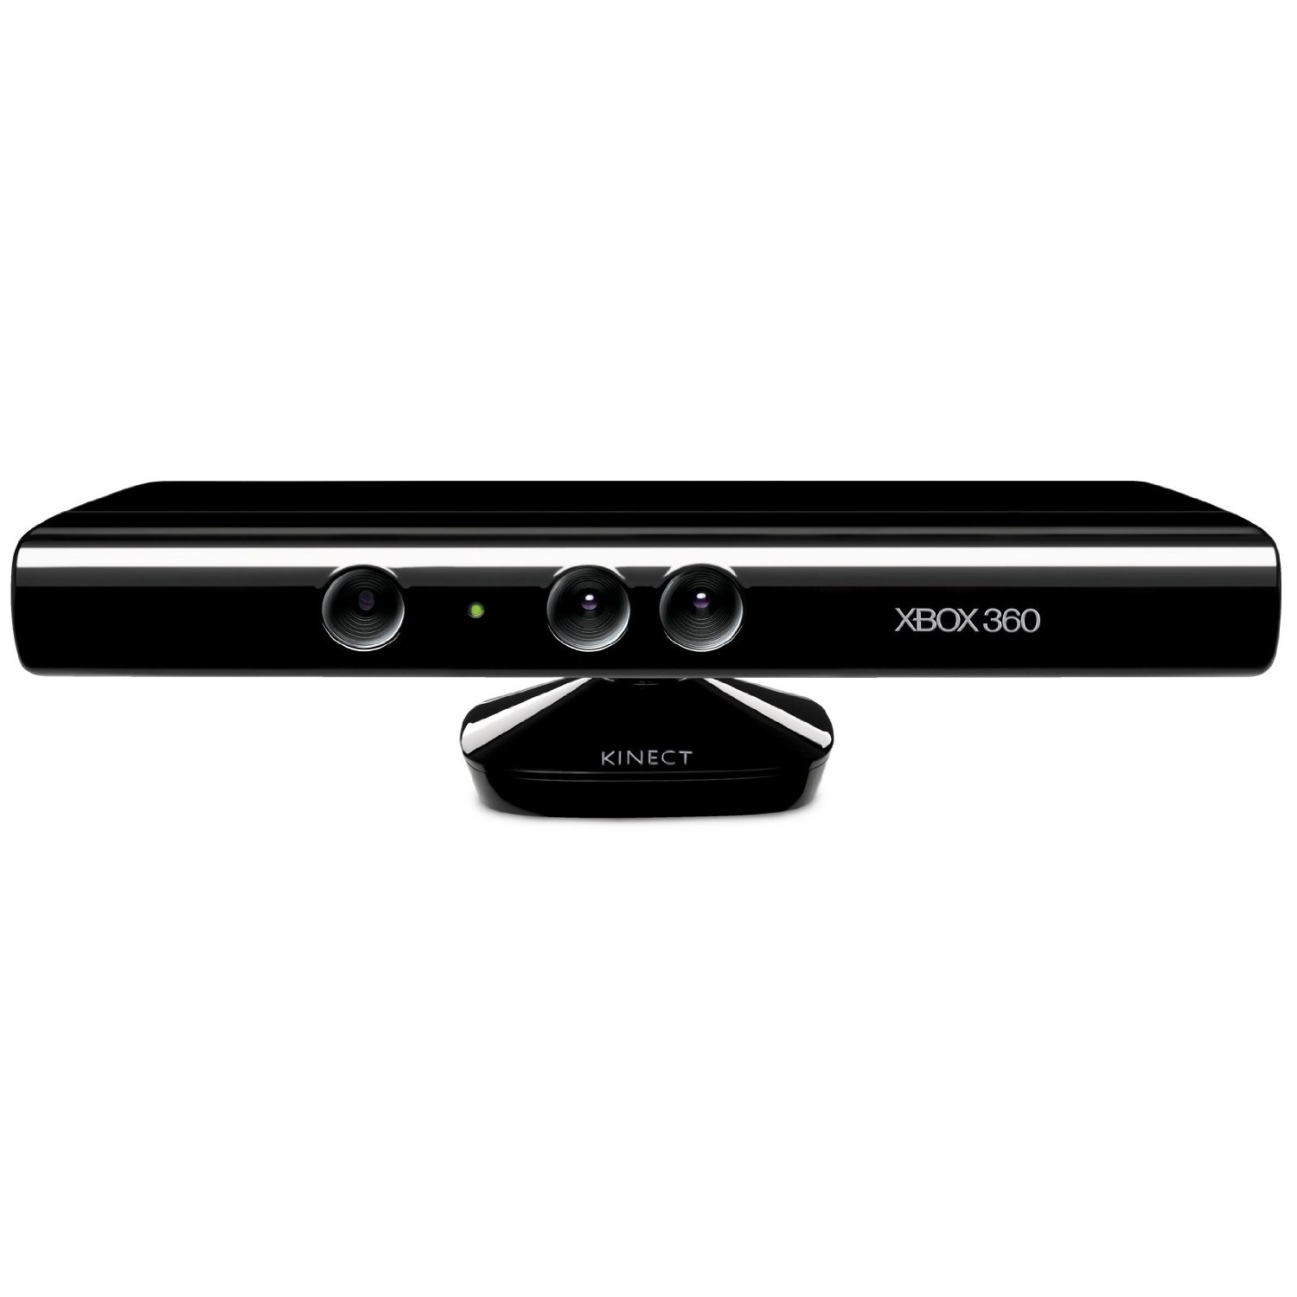


Technologies
Microsoft Kinect (for XBOX360)
Visual Studio 2010 C++
Point Cloud Library 1.7
  OpenNI
  VTK
  Qt 4.8.4
  Eigen library
  boost

Slide 4
Planned approach
3D model
  Alignments of current view with 3D model
  Object labeling
  Kinfu
Person tracking
  Collision detection with objects
  Bounding boxes

Slide 5
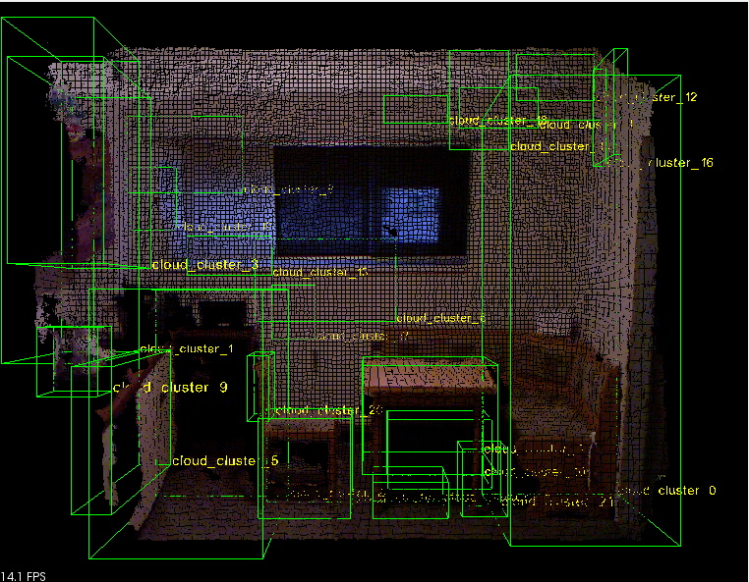
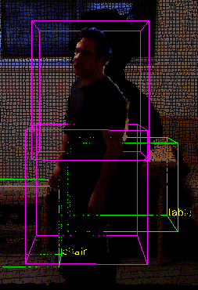
Actual approach
Room segmentation
  Segmenting single point cloud
  Euclidian cluster extraction
  Convex hull
  Labeling
Person tracking
  Live data from Kinect
  Collision detection with objects
  Bounding boxes
  Navigation

Slide 6
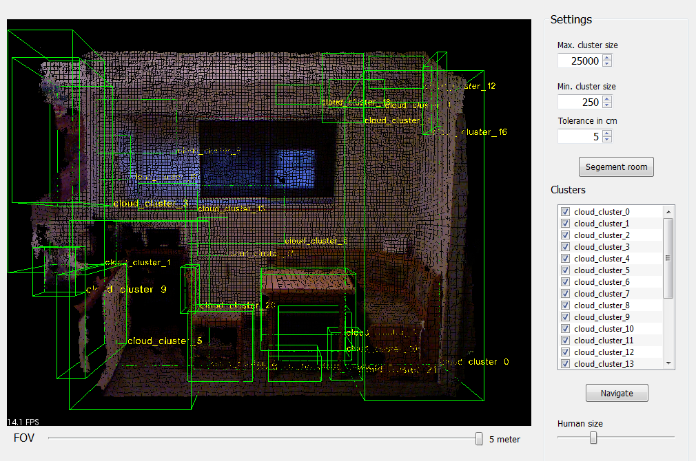
User Interface
2/5/2013
Fischl/ Hochmayr

Slide 7
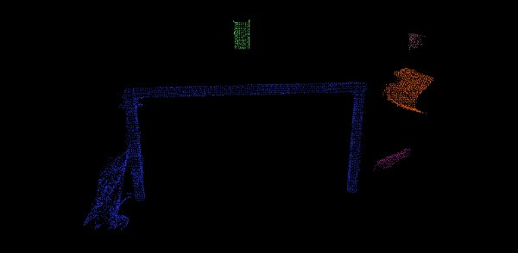
Euclidian cluster extraction
Octree data structure
Nearest neighbour
Similiar to flood-fill algroithm
Planar objects
Convex hull filtering
Cluster size
Tolerance

Slide 8
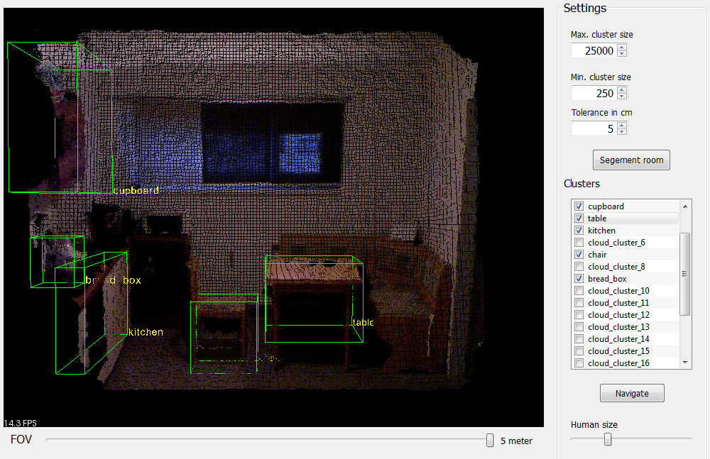
Labeling
Select collidable objects
Name objects

Slide 9
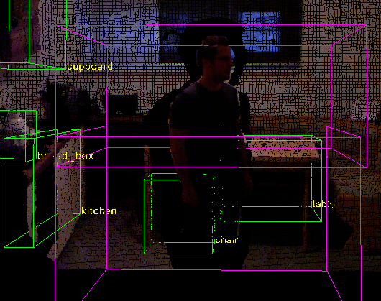
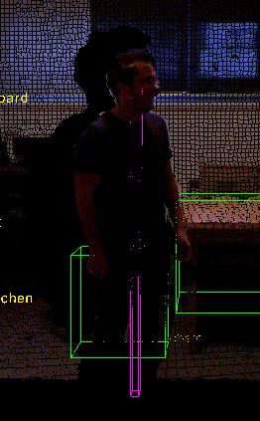
People tracking
OpenNI
Upper and lower body
Bounding box
  Scalable size
  Intersection
Navigation
Sounds

Slide 10
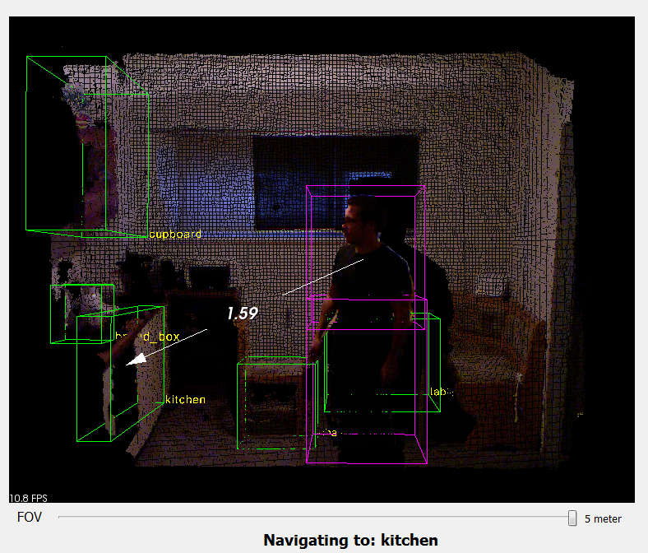
Navigation
05/02/2013
Fischl/ Hochmayr

Slide 11

Video

Slide 12
Results
Room segmentation > 5min
  Good results (depending on Kinect)
  Only one viewpoint -> restriction
Detecting person
  Takes a little bit too long (system dependent)
Intersection and navigation
Works in dark environments

Slide 13
Issues
PCL 1.7 compilation
Kinfu
Stability problems
Segmentation
  Colour based region growing
  Min – Cut based segmentation
Change viewer
Manual configuration

Slide 14
Improvements
Voice output/ control
Link different sounds to different objects
More robust segmentation
Multi -User tracking

Slide 15
Thank you for your attention!
Questions?

