Slide 1
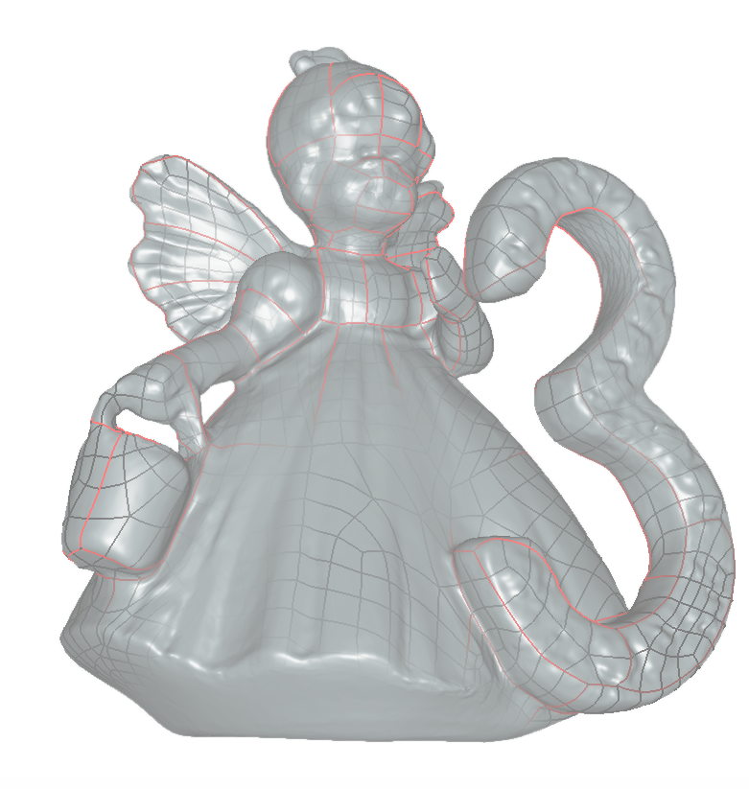
3D Vision
15.02.2018
Robert Sablatnig
Tutoren: Fabian Hollaus, Simon Brenner

Slide 2
Lecture Schedule
3D scanning [April 9th – April 27th]
At the institute [HA0420, Favoritenstraße 9]
Tutorium [May 14nd – June 18nd]
Pong Room [HGEG15, Favoritenstraße 9]
Monday [12:00 – 14:00]
Thursday [11:00 – 13:00]
Deadlines
Presentation End of June (TBA)
Final Model & Documentation after presentation

Slide 3
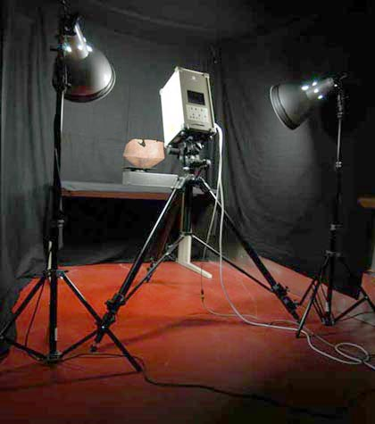
Course overview
Team size
2-3 students – 1 Object per student
Tasks:
Scan an object (of your choice) with our Minolta laser scanner OR with our Aicon Structured Light Scanner
Create a Structure from Motion model of the same object by taking photos and processing them with a suitable software
Compare the outputs

Slide 4
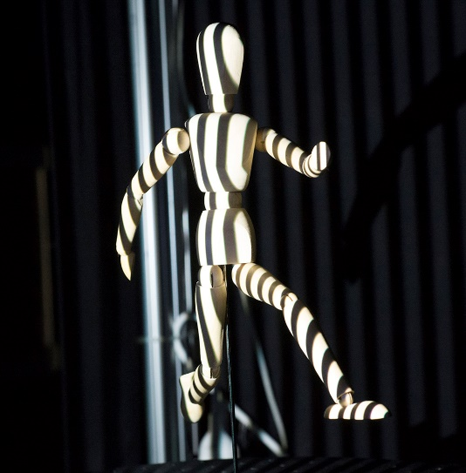
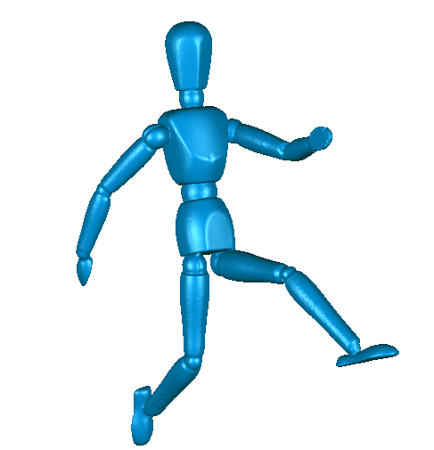
3D Scanning – Minolta / Aicon
Near-range laser / Structured Light scanner
Triangulation
1 object per student
Bring your own object
Tasks
Noise removal, registration and merging
Waterproof 3D Model
Evaluation

Slide 5
Structure from Motion
Take good pictures
Create 3D model with SfM software, e.g
VisualSFM: open source, very basic
Agisoft Photoscan: commercial, lots of nice feastures, 30 days full trial available
Export model and refine it in Geomagic (noise removal etc)
Waterproof 3D model not necessary, but nice-to-have
Compare output to scanned object

Slide 6
Tips for taking pictures
Use proper camera! If you don‘t have access to one, we have two Nikons + tripods at the lab.
Use a small aperture (e.g. f20) for high DoF
Use a tripod when indoors (small aperture→longer exposure)
Move around the object at constant height and distance in ~10°-steps; do several rounds from different heights.
Make raw images and convert them to TIFFs → no data loss! (Unfortunately VisualSfM doesn‘t support TIFFs..)
If your object has little texture, put it onto something textured (e.g. newspaper)
Put a ruler in the scene! So you can correctly scale your object afterwards.

Slide 7
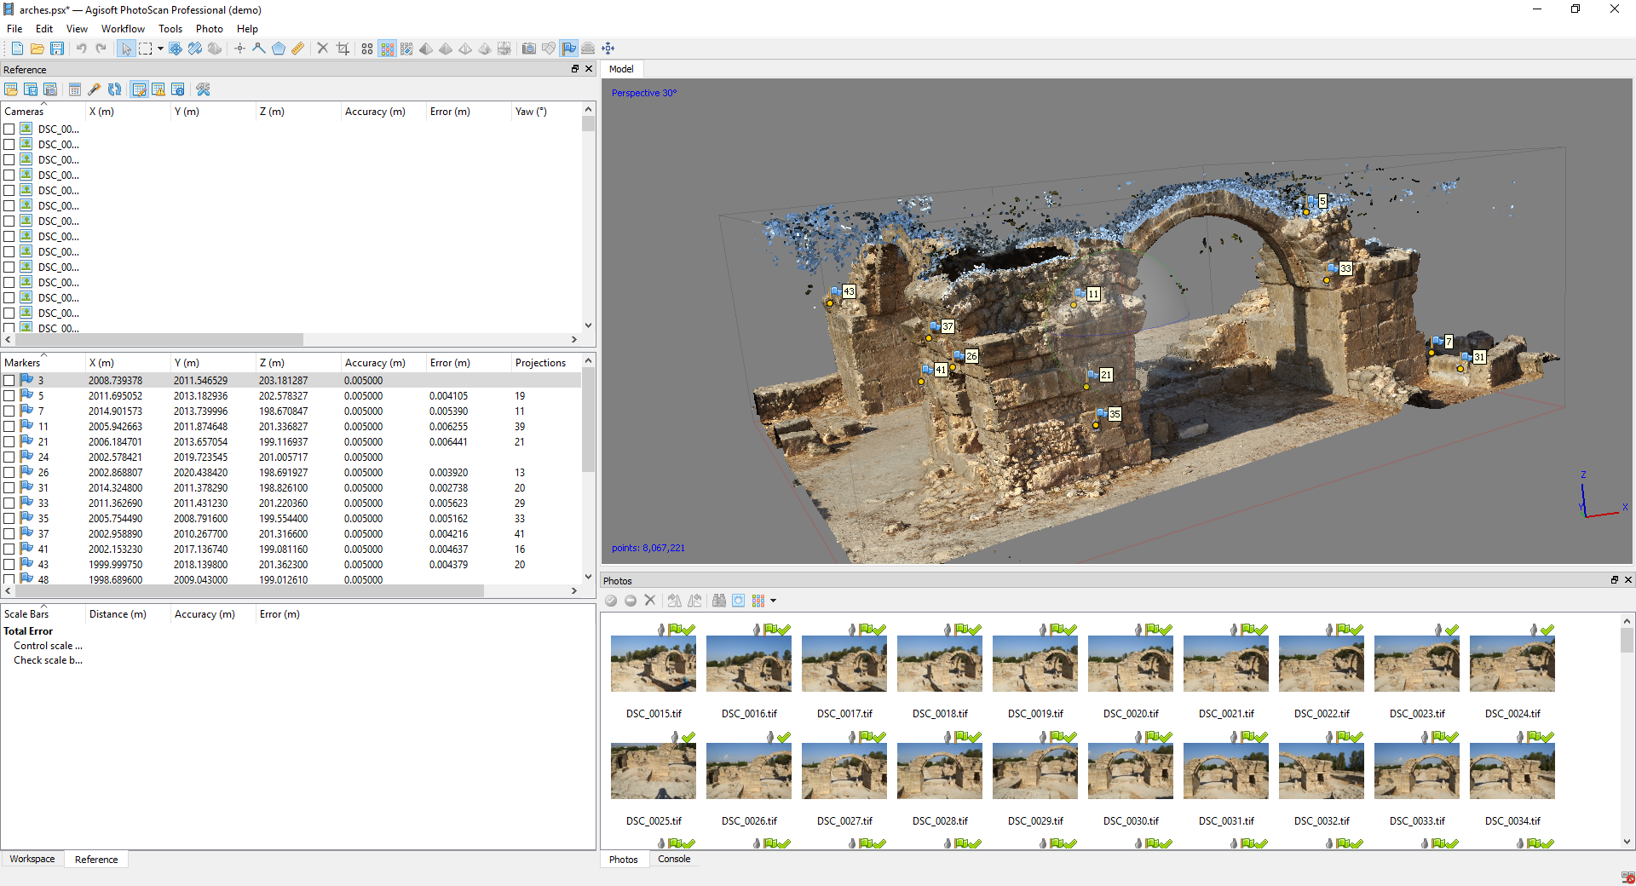
Example Photoscan

Slide 8
The Object
Choose an object which you can access througout the whole term
Size: apple - pinapple
Ideally a waterproof object
Matte surface, moderately texture
Lots of texture → hard for scanner
Little texture → hard for SfM
➔ Find trade-off

Slide 9
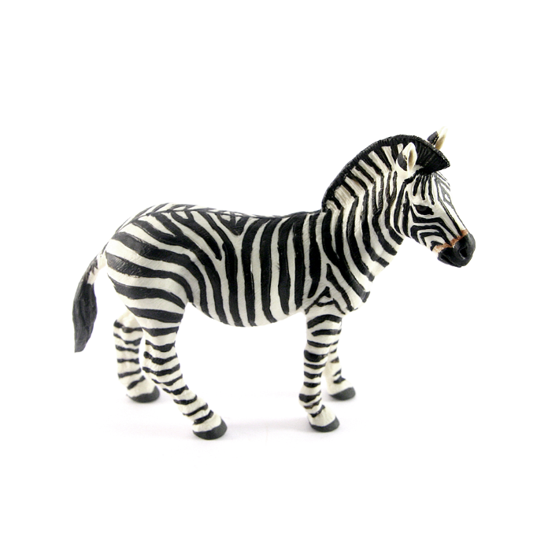
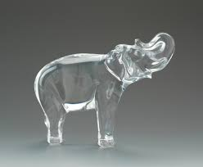
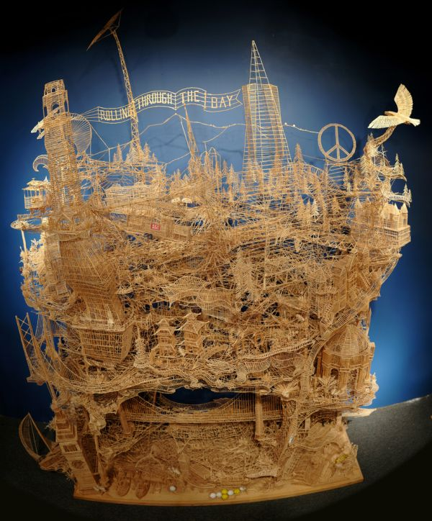
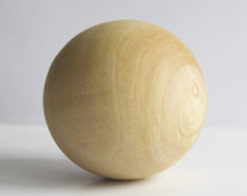
Dont‘s!
shiny
Transparent /translucent
High contrast texture
Too complex / cavities
Too simple / symmetric
deformable

Slide 10
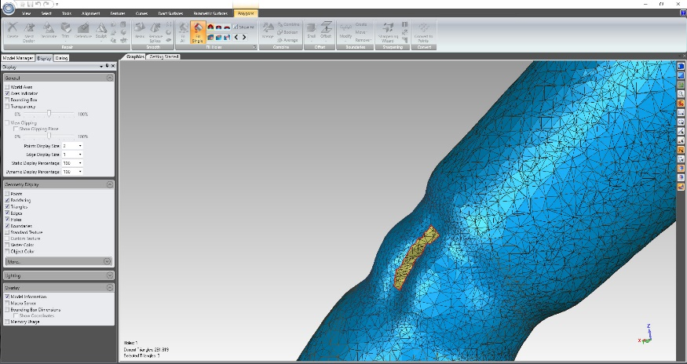
Geomagic
Professional 3D editing software
Registration, noise removal, hole filling etc.
Validation
On Lab PCs: Geomagic Studio 12 installed
@ Home:
Geomagic Studio is discontinued since 2015
Geomagic Wrap is the equivalent successor
You can use fully functional trial for 15 Days (should be enough time..)

Slide 11
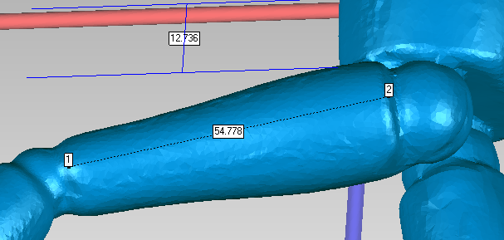
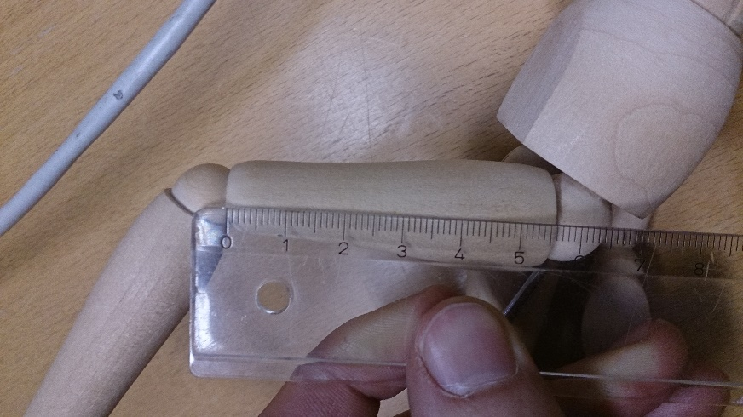
Documentation
2-4 pages per student
Show your results
Give a short evaluation (meassure the scanner‘s accuracy)
Write about the lessons learned when modelling your object
Do not explain how the scanner works

Slide 12
Presentation
Length
5-7 minutes
Maximally 12 slides (including title page)
Content
Intermediate results
Point out troubles when modelling your object
Give a short evaluation
Compare the model‘s volume with the physical one

Slide 13
thank you
Registration is now open. Please register for the course via TISS.

